Slide 1
Analysis of Athlete Dataset
A Comprehensive Study on Athlete Demographics and Trends

Slide 2
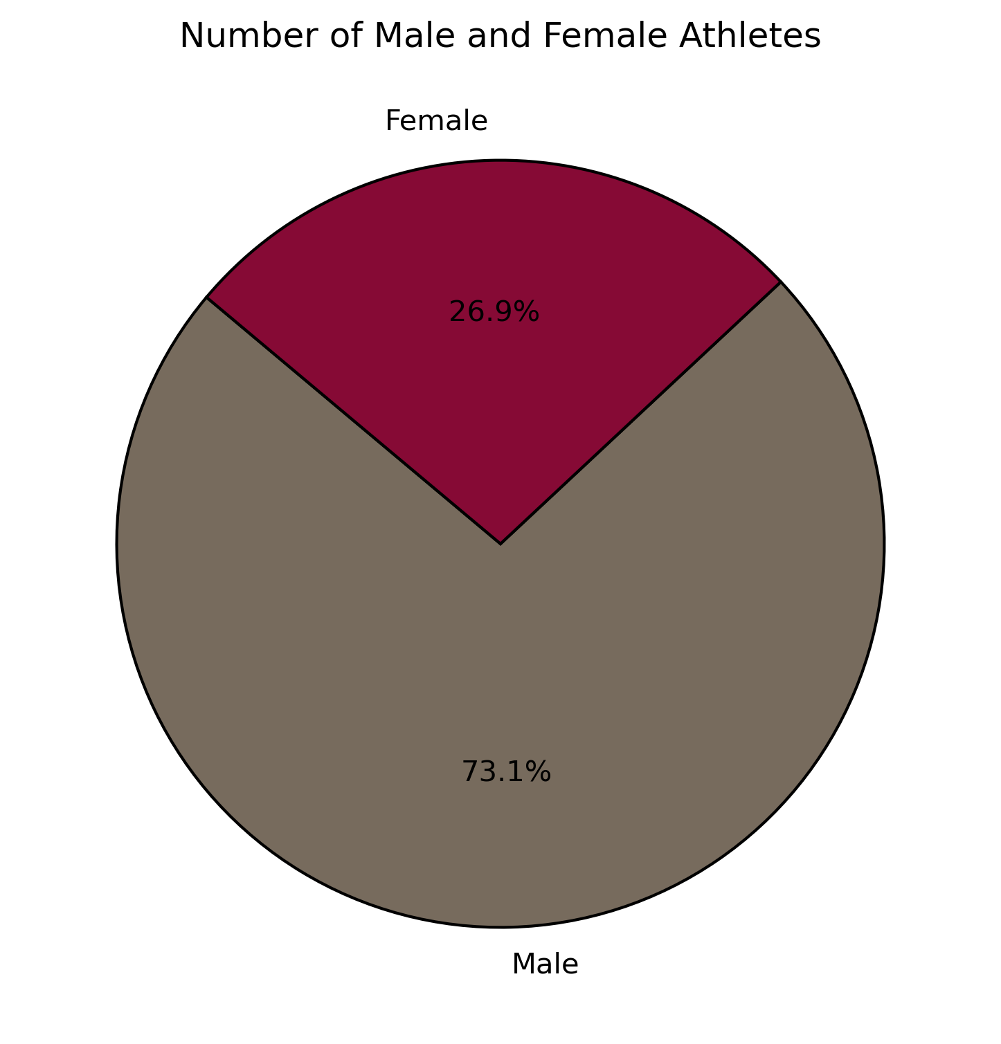
Gender Distribution of Athletes
Notes:
This pie chart illustrates the gender distribution among athletes in our dataset . "We can see that the majority of athletes are Male, with 73.1% of the total. The remaining 26.9% are Female. This distribution highlights [majority of athletes are men, and the percentage of the females is relatively low. Understanding gender representation is crucial for analyzing diversity within the sport."

Slide 3
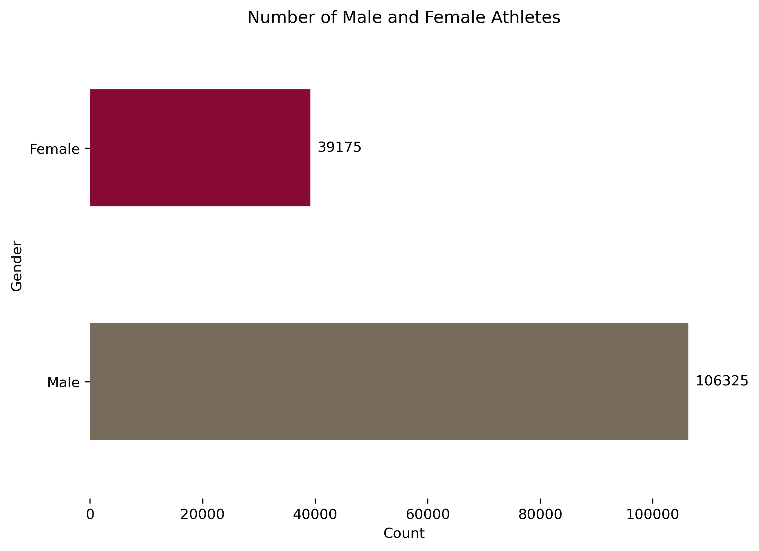
Number of Male and Female Athletes
Notes:
This horizontal bar chart provides a clear comparison of the total number of male and female athletes in our dataset. The chart shows that there are significantly more male athletes, with a total of 106,325 compared to 39,175 female athletes. The substantial difference in numbers highlights a notable gender disparity in this dataset. Understanding this imbalance can help in discussions about gender representation and targeted efforts to promote diversity in sports."

Slide 4
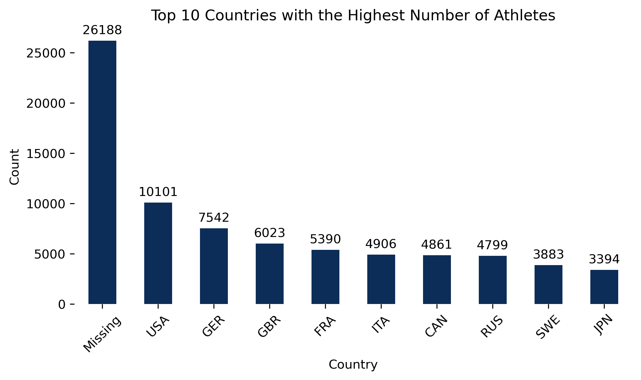
Top 10 Countries with the Most Athletes

Slide 5
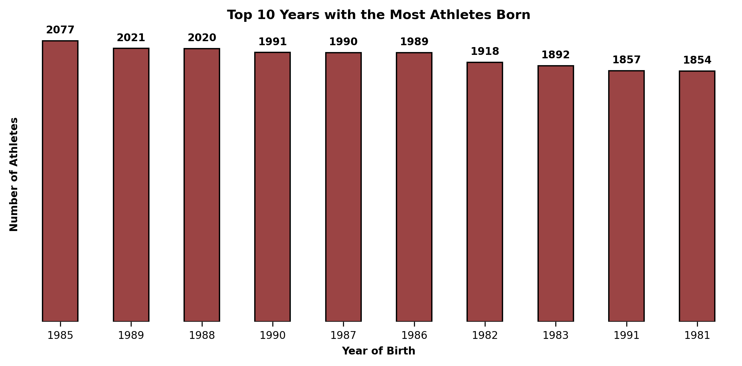
Top 10 Birth Years for Athletes

Slide 6
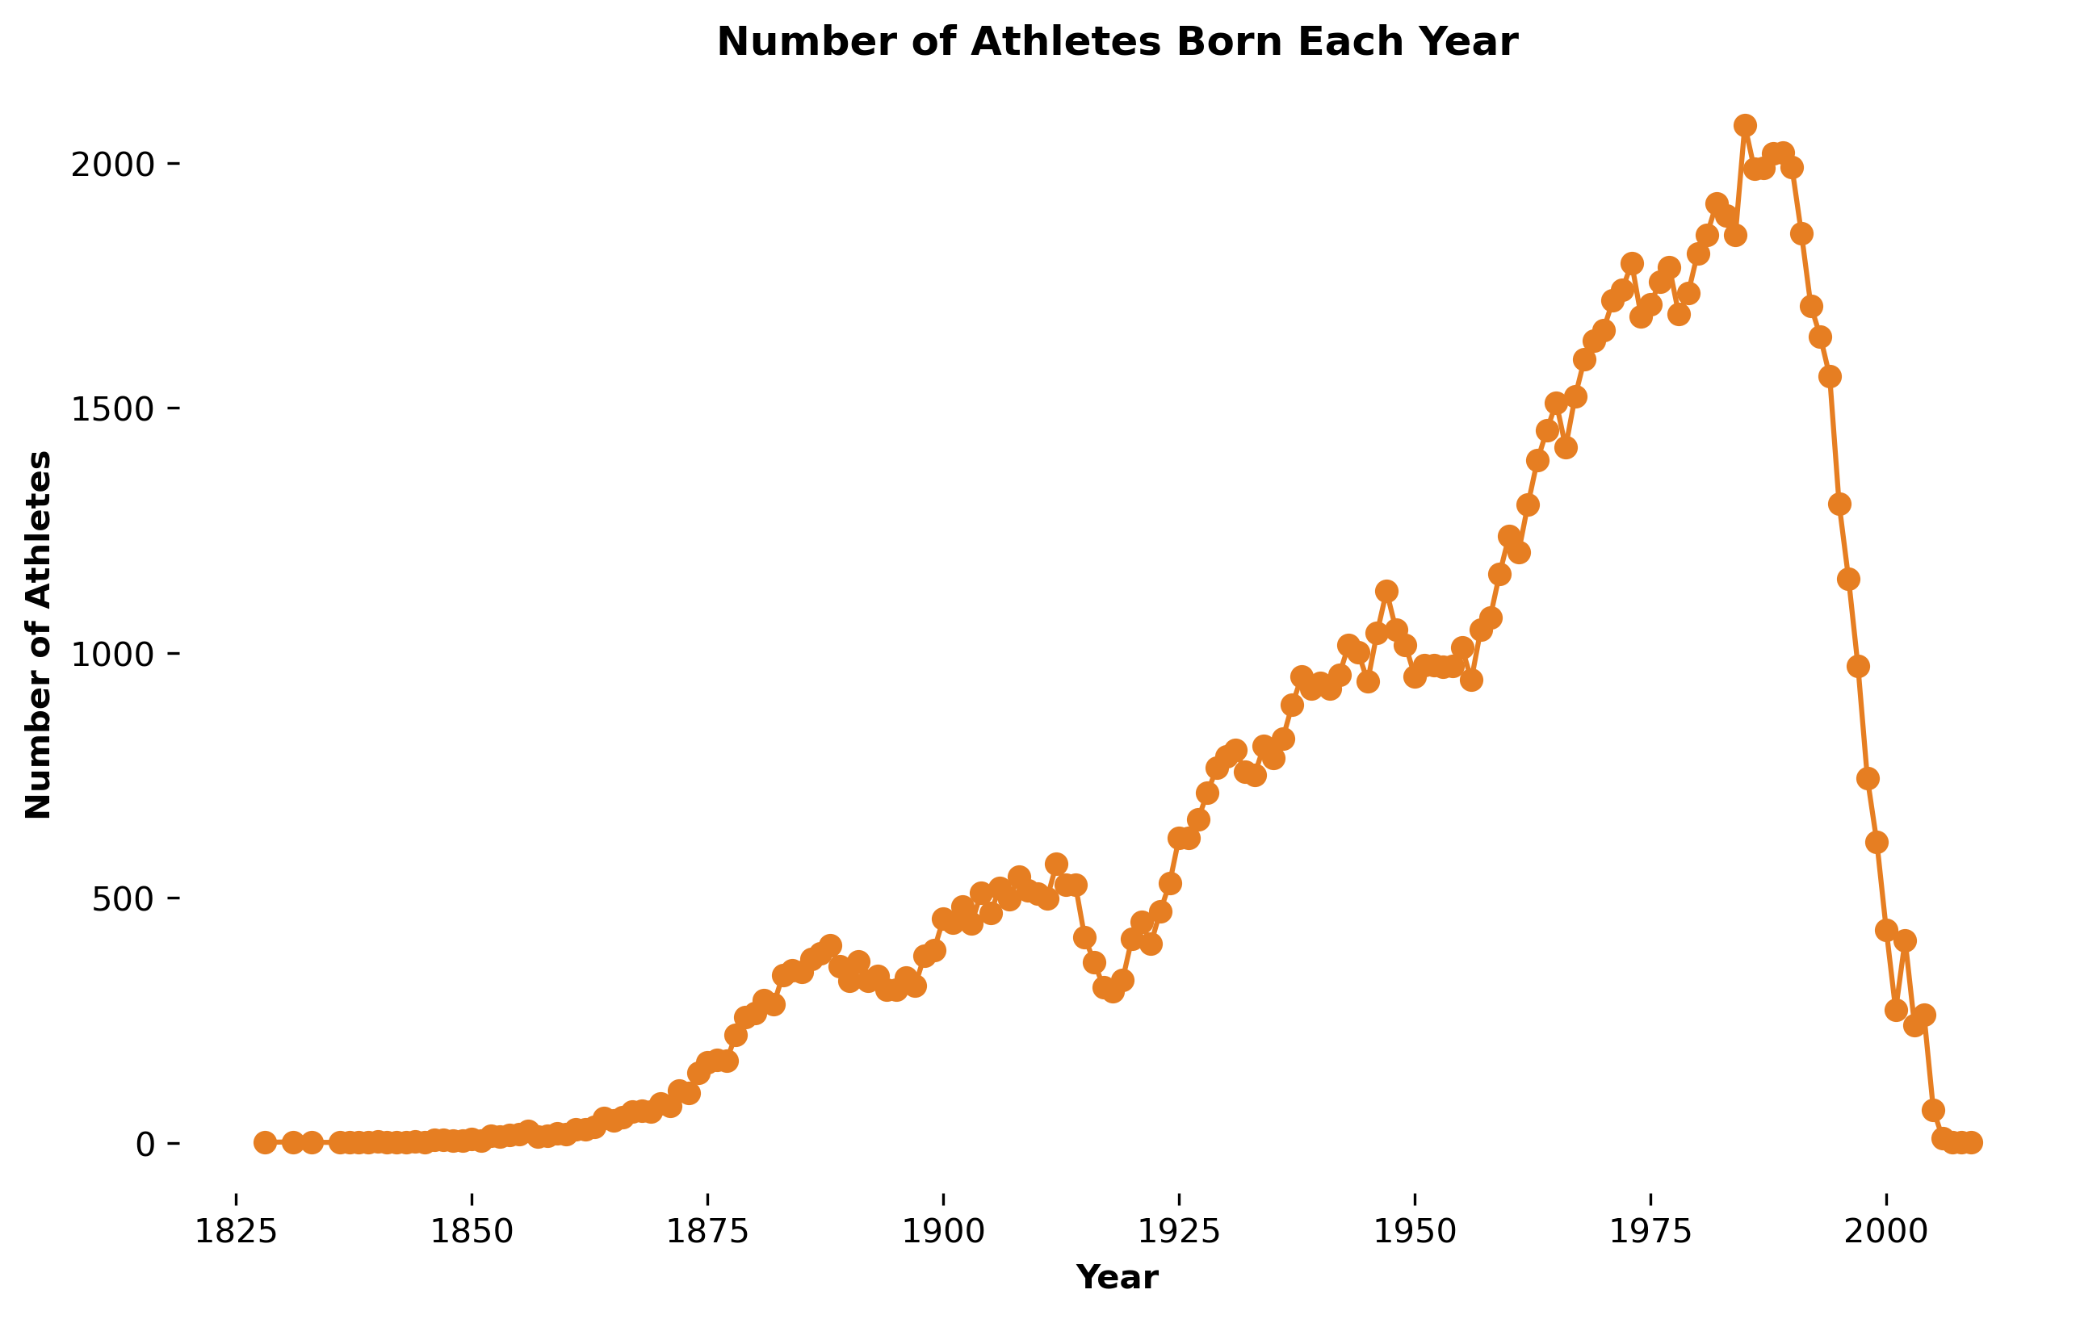
Athlete Birth Trends Over Time

